Slide 1
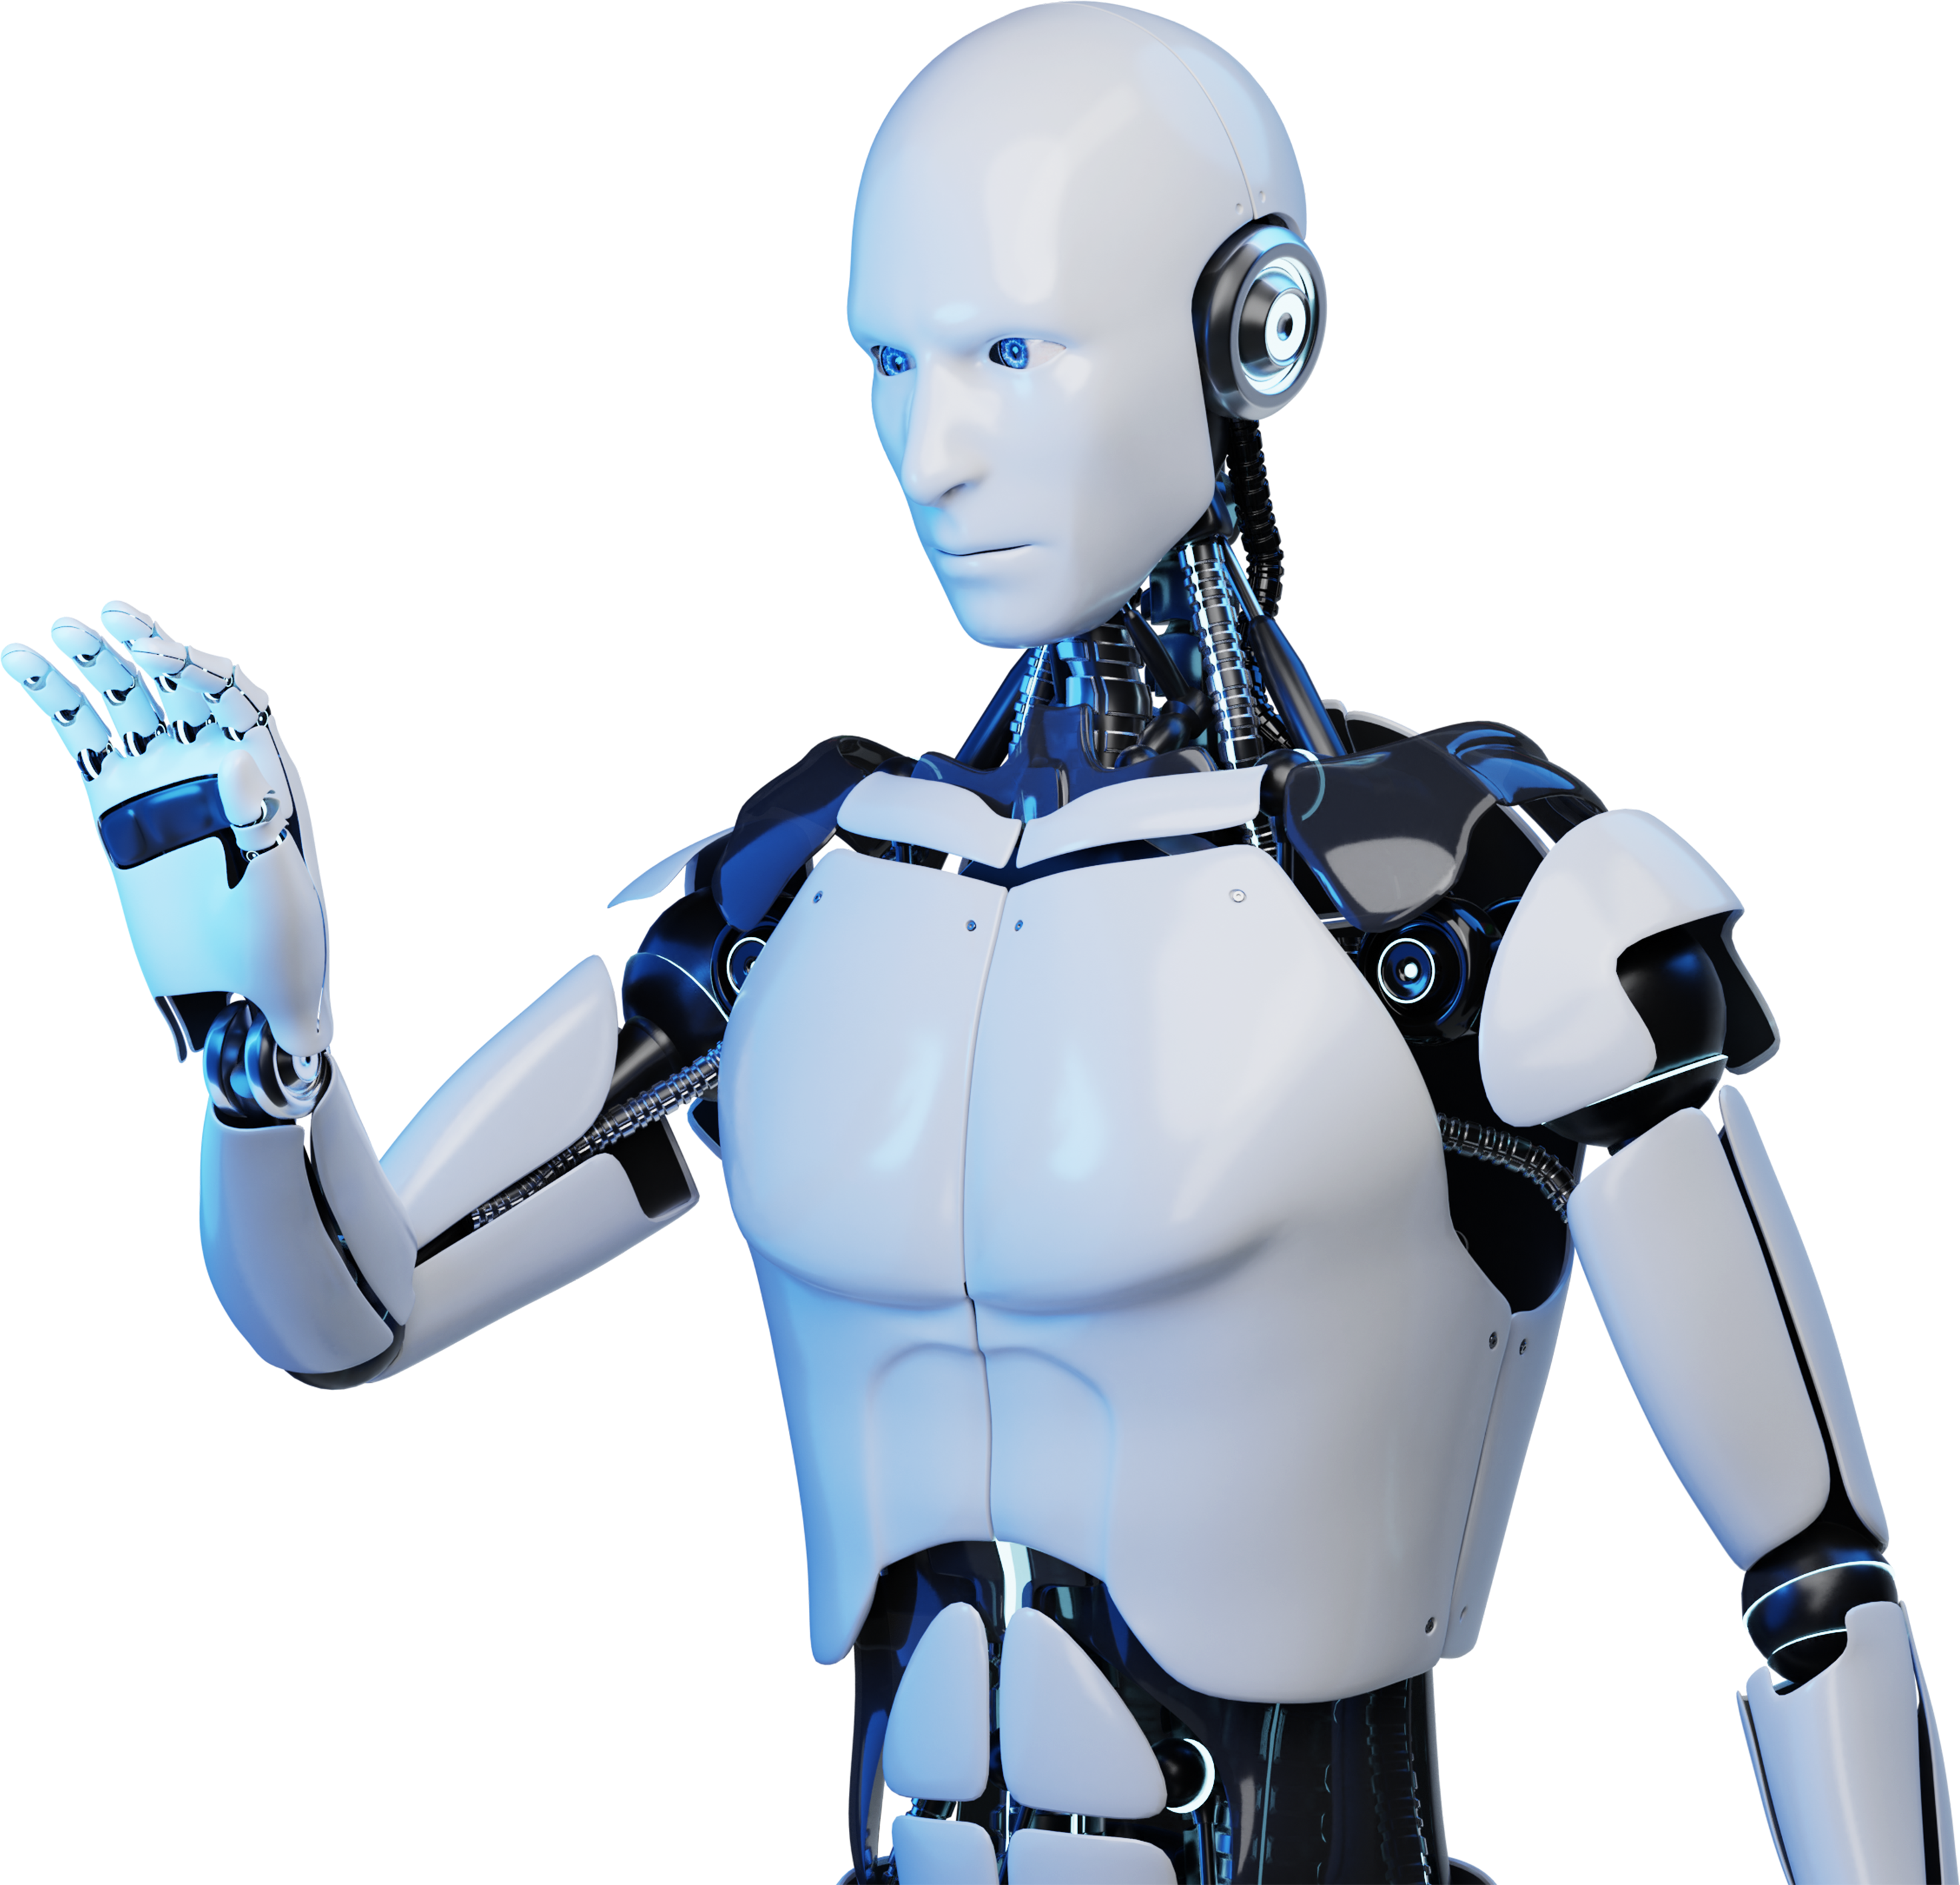
AI Chatbot
Presented By
Ch Eswar
G Monish Kumar
PV Santhan

Slide 2
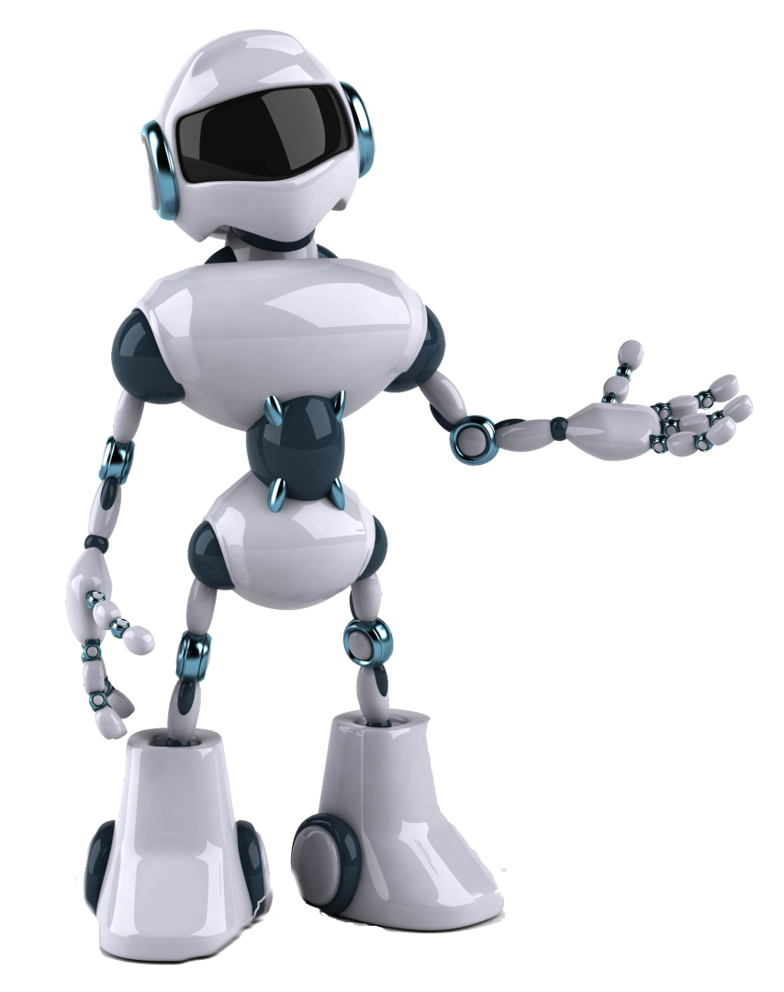
Introduction
AI Chatbots are computer programs that simulate human conversation, using artificial intelligence to interact with users and provide assistance.

Slide 3

Advantages In Customer Service
AI Chatbots in customer service offer 24/7 availability, quick response times, personalized interactions, and efficient issue resolution.

Slide 4

Enhancing
User Experience
By providing seamless and personalized interactions, AI Chatbots enhance user experience, making interactions more efficient and satisfying.

Slide 5
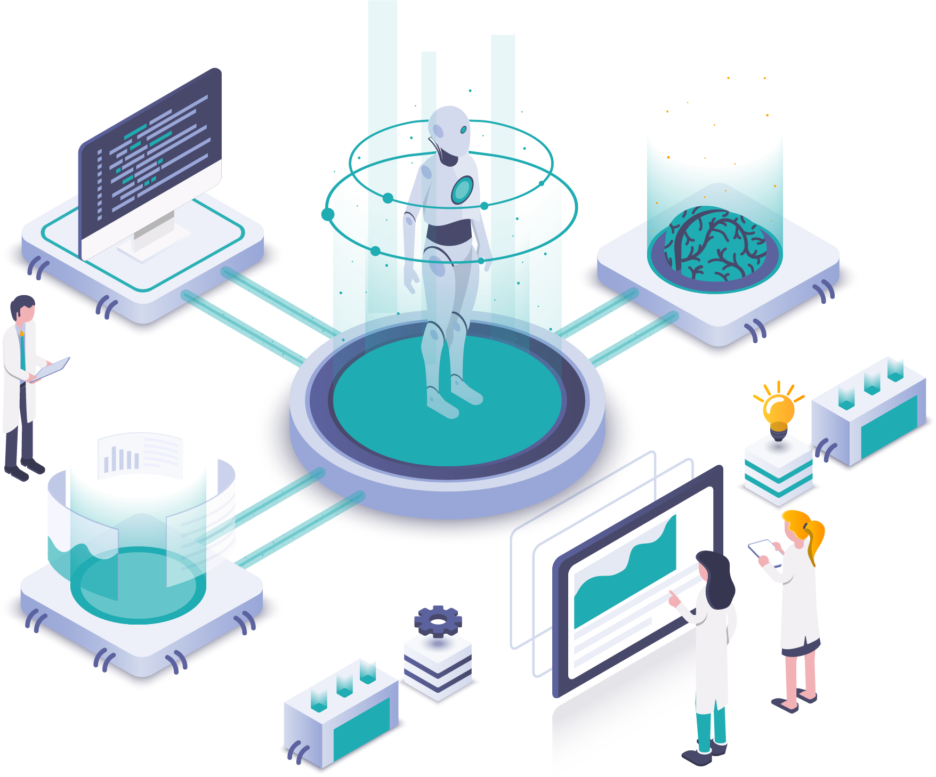
Role Of NLP
Natural Language Processing (NLP) enables AI Chatbots to understand and process human language, allowing for more effective communication.

Slide 6
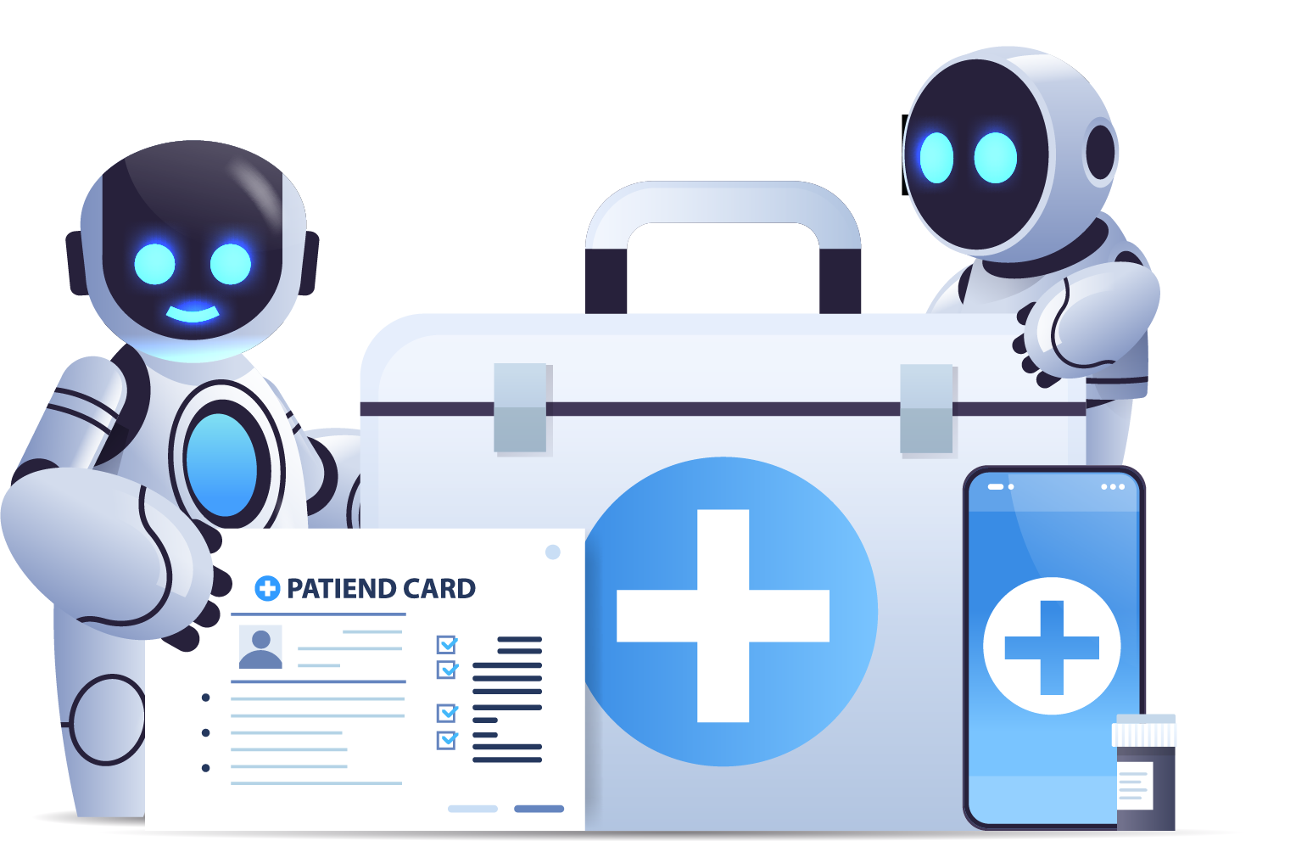
AI Chatbots In Healthcare
Symptom Assessment and Advice
AI Chatbots provide preliminary medical guidance based on symptoms.
Appointment Management
AI Chatbots assist in scheduling and reminding patients of healthcare appointments.
Health Monitoring and Education
AI Chatbots offer personalized health monitoring and educational resources.

Slide 7

AI Chatbots In E-commerce
AI Chatbots in e-commerce offer personalized product recommendations, assist in purchase decisions, and provide seamless customer support and assistance.

Slide 8
Natural Language Understanding
Lack of Contextual Understanding
Emotional Intelligence
Handling Complex Queries
Lack of Creativity and Empathy
Challenges and limitations
Data Privacy and Security
User Trust and Transparency
Maintenance and Updates

Slide 9

AI Chatbots In Education
AI Chatbots in education facilitate personalized learning experiences, provide instant feedback, and support student engagement and progress tracking.

Slide 10
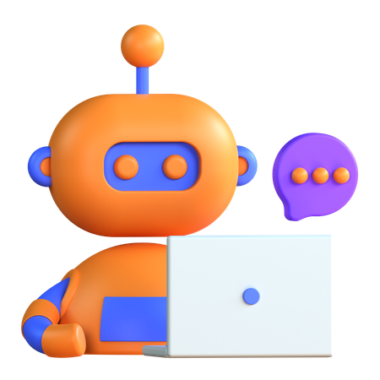
Future Trends In Technology
Future trends in technology include advancements in AI Chatbot capabilities, such as improved natural language understanding and contextual conversations.

Slide 11

Conclusion
In conclusion, AI Chatbots revolutionize customer service, enhance user experiences, and drive operational efficiency, empowering businesses to thrive.

